Slide 1

Functional dependencies and attribute closure
Database Management System | Database Design and Advanced Normalization
Course: Database Management System | Chapter: Database Design and Advanced Normalization | Program: Bachelor of Engineering
DISCOVER · LEARN · EMPOWER
Notes:
Welcome everyone to today's lecture on Database Design. We will dive deep into the mathematical foundations that ensure our database schemas are robust. Specifically, we are focusing on functional dependencies and how to calculate attribute closure. This is the key to eliminating redundancy and ensuring data integrity.

Slide 2
Course Outcomes
SLIDE 2 / 14
Course Outcome
CO | BT LEVEL | DESCRIPTION
CO1 | BT2 | Explain database architecture, relational model concepts and formal query language foundations including relational algebra and relational calculus.
CO2 | BT3 | Apply relational algebra, relational calculus and SQL constructs to formulate correct and efficient database queries.
CO3 | BT4 | Analyze functional dependencies and design normalized relational schemas up to 5NF ensuring lossless join and dependency preservation.
CO4 | BT4 | Analyze transaction schedules and concurrency control mechanisms to determine serializability, recoverability and correctness.
CO5 | BT5 | Evaluate storage structures, indexing strategies and query optimization techniques for performance, scalability and reliability.
Chandigarh University
2 / 14
Notes:
Today's session directly supports our Course Outcomes CO4 and CO5. By understanding functional dependencies, you learn to analyze data structures for correctness and serializability. Furthermore, this knowledge allows you to evaluate storage structures and optimize query performance effectively. These concepts are the backbone of reliable database design.

Slide 3
Learning Objectives
SLIDE 3 / 14
Learning Outcomes
1
Define functional dependencies and their role in normalization.
2
Analyze the properties of functional dependencies including reflexivity and transitivity.
3
Compute the closure of an attribute set using Armstrong's axioms.
4
Determine candidate keys by calculating attribute closures systematically.
5
Identify common pitfalls in dependency analysis and closure computation.
Chandigarh University
3 / 14
Notes:
By the end of this lecture, you will be able to define functional dependencies clearly. You will analyze the core properties like reflexivity and transitivity. Most importantly, you will learn to compute attribute closures to find candidate keys. We will also identify common pitfalls to avoid during your design process.

Slide 4
Lecture
SLIDE 4 / 14
Definition of Functional Dependency
1
A functional dependency X → Y means Y is determined uniquely by X.
2
Every value of X in the relation must map to exactly one Y value.
3
If two tuples have the same X value, they must have the same Y value.
4
This constraint ensures data consistency and eliminates redundant data storage.
5
Functional dependencies are the foundation for all normalization forms in design.
Chandigarh University
4 / 14
Notes:
Think of a functional dependency as a rule where one attribute dictates another. If you know the student ID, you must know the student name uniquely. If two rows have the same ID, the name must be identical. This rule prevents data anomalies and ensures our database remains consistent.

Slide 5
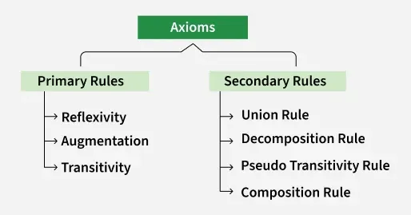
Lecture
SLIDE 5 / 14
Armstrong's Axioms for Inference
REFLEXIVITY
If Y is a subset of X, then X → Y holds true.
AUGMENTATION
If X → Y holds, then XZ → YZ also holds for any Z.
TRANSITIVITY
If X → Y and Y → Z, then X → Z must hold.
• These axioms allow us to derive all valid functional dependencies logically.
• They form the basis for computing attribute closures efficiently and accurately.
Source: media.geeksforgeeks.org
Chandigarh University
5 / 14
Notes:
Armstrong's axioms are the logical rules we use to derive new dependencies. Reflexivity is simple: a set of attributes determines itself. Augmentation allows us to add attributes to both sides of a dependency. Transitivity is like a chain reaction where A determines B, and B determines C, so A determines C.

Slide 6
Lecture
SLIDE 6 / 14
Derived Rules of Inference
UNION
If X → Y and X → Z, then X → YZ holds.
DECOMPOSITION
If X → YZ, then X → Y and X → Z hold.
PSEUDOTRANSITIVITY
If X → Y and WY → Z, then WX → Z holds.
• These derived rules simplify the process of finding all implied dependencies.
• They are essential for analyzing complex schemas with multiple attributes.
Chandigarh University
6 / 14
Notes:
Beyond the basic axioms, we have derived rules that make our work easier. Union allows us to combine two dependencies with the same left side. Decomposition lets us split a dependency into smaller parts. Pseudotransitivity helps us chain dependencies where the right side of one matches the left side of another.

Slide 7
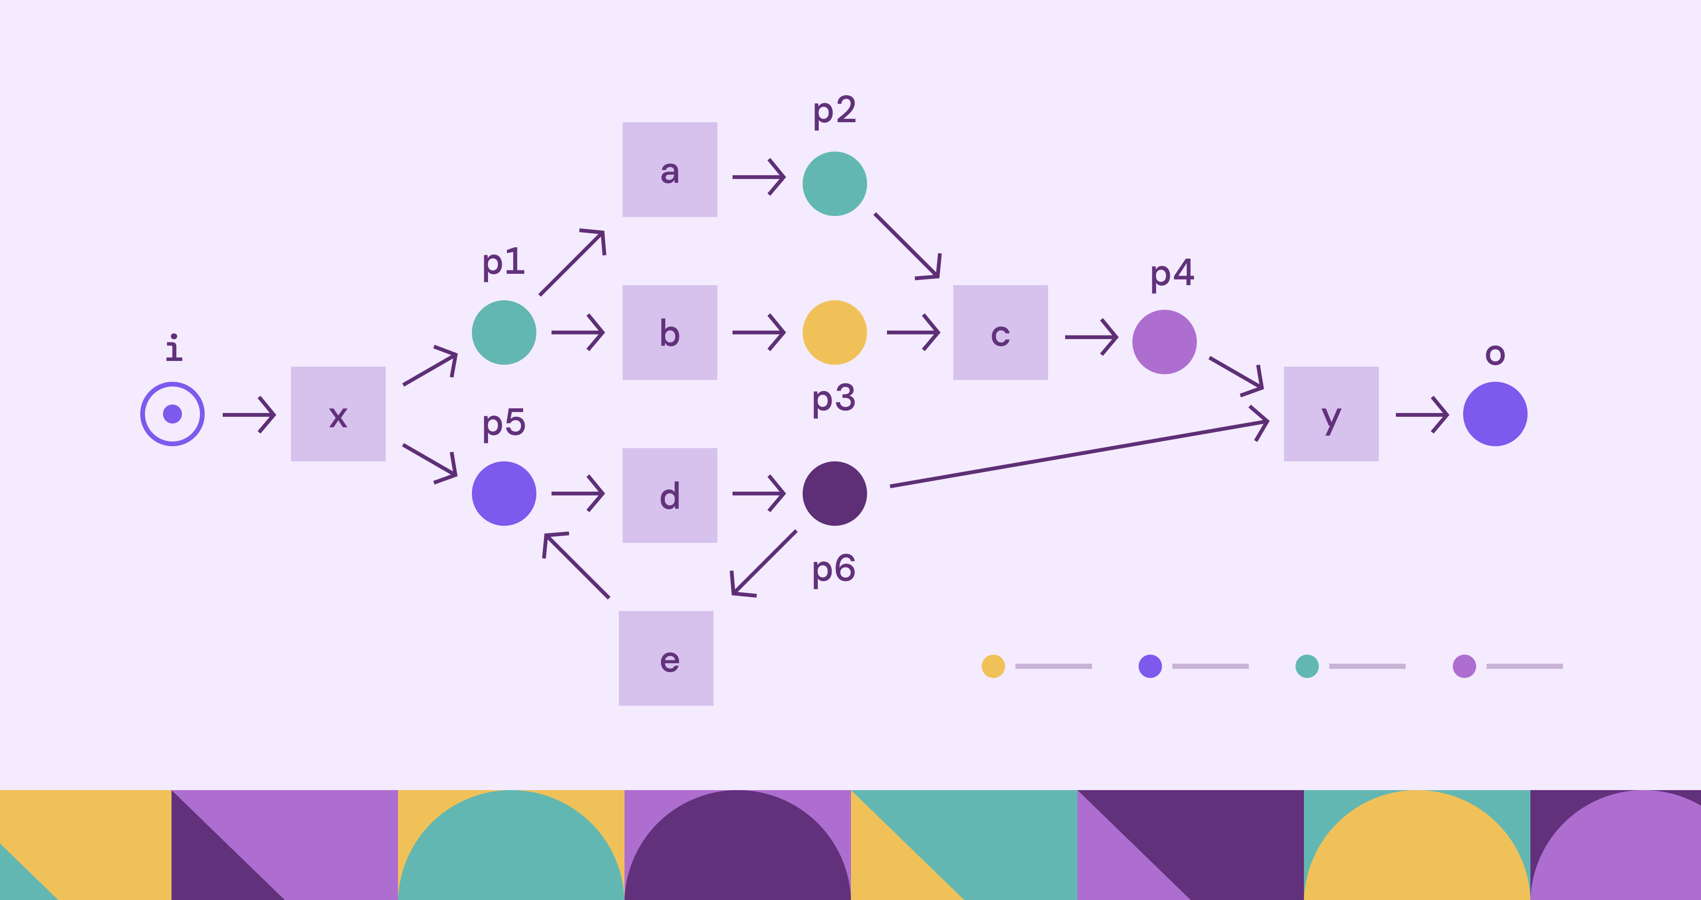
Lecture
SLIDE 7 / 14
Concept of Attribute Closure
1
The closure of a set X, denoted X+, is all attributes functionally determined by X.
2
It includes X itself plus all attributes reachable via functional dependencies.
3
Calculating closure helps us find candidate keys and superkeys in a schema.
4
An attribute set is a superkey if its closure contains all relation attributes.
5
This concept is critical for identifying the minimal set of keys.
Source: cdn.prod.website-files.com
Chandigarh University
7 / 14
Notes:
Attribute closure is the set of all attributes that can be determined by a given set. If you start with a set of attributes, you keep adding attributes until no new ones can be found. This process tells us if a set of attributes is a superkey or a candidate key.

Slide 8
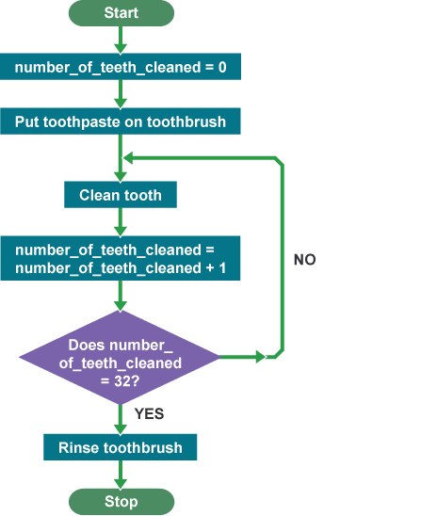
Lecture
SLIDE 8 / 14
Algorithm to Compute Closure
1
Initialize the result set X+ with the attributes in the starting set X.
2
Iteratively scan all functional dependencies in the relation schema.
3
If the left side of a dependency is contained in the current result, add the right side.
4
Repeat the scan until no new attributes can be added to the result set.
5
The final set is the complete closure X+ for the given input.
Source: bam.files.bbci.co.uk
Chandigarh University
8 / 14
Notes:
The algorithm is straightforward but requires careful iteration. We start with our initial set and check every dependency. If the left side matches what we have, we add the right side to our collection. We repeat this until the set stops growing, giving us the full closure.

Slide 9

Worked Example
SLIDE 9 / 14
Computing Closure
COMPUTE CLOSURE OF A
Start with {A}, add B to get {A, B}.
• Given relation R(A, B, C, D) with dependencies: A → B, B → C, C → D.
• From {A, B}, use B → C to add C, resulting in {A, B, C}.
• From {A, B, C}, use C → D to add D, resulting in {A, B, C, D}.
• Since A+ contains all attributes, A is a candidate key for this relation.
Source: mylittleeater.com
Chandigarh University
9 / 14
Notes:
Let's walk through a concrete example. We start with A. Since A determines B, we add B. Now we have A and B. Since B determines C, we add C. Finally, C determines D, so we add D. The closure is all attributes, proving A is a key.

Slide 10

Worked Example
SLIDE 10 / 14
Finding Candidate Keys
COMPUTE CLOSURE OF AC
Start with {A, C}, add B and D to get {A, B, C, D}.
COMPUTE CLOSURE OF A
Result is {A, B}, which is not all attributes.
COMPUTE CLOSURE OF C
Result is {C, D}, which is not all attributes.
• Given R(A, B, C, D) with dependencies: A → B, C → D.
• Since AC+ is all attributes and no subset works, AC is a candidate key.
Source: www.burkeenergy.com
Chandigarh University
10 / 14
Notes:
Now let's find a candidate key for a slightly different schema. A alone gives us B, but not C or D. C alone gives us D, but not A or B. However, combining A and C gives us everything. Thus, AC is the candidate key because it uniquely identifies every row.

Slide 11
Lecture
SLIDE 11 / 14
Minimal Cover of Functional Dependencies
1
A minimal cover is a simplified set of dependencies equivalent to the original.
2
It removes redundant dependencies and extraneous attributes from the left side.
3
The process involves decomposing right sides, removing redundant dependencies, and minimizing left sides.
4
Using a minimal cover simplifies the normalization process significantly.
5
It ensures the schema is in the most efficient form for design.
Chandigarh University
11 / 14
Notes:
Sometimes our list of dependencies is messy. A minimal cover simplifies this list without changing the meaning. We remove redundant rules and unnecessary attributes on the left side. This makes the normalization process much cleaner and easier to manage for complex databases.

Slide 12
Lecture
SLIDE 12 / 14
Common Pitfalls in Closure Computation
1
Failing to check all dependencies in every iteration of the algorithm.
2
Assuming a single dependency is sufficient without checking transitive chains.
3
Ignoring the reflexive property when initializing the closure set.
4
Mistaking a superkey for a candidate key without checking minimality.
5
Overlooking dependencies that span multiple attributes on the left side.
Chandigarh University
12 / 14
Notes:
Students often make mistakes when computing closures. They might stop too early or miss a transitive link. Another common error is confusing a superkey with a candidate key. Remember, a candidate key must be minimal, meaning no subset of it can also be a superkey.

Slide 13
Lecture
SLIDE 13 / 14
Key Takeaways
1
Functional dependencies define unique relationships between attributes in a relation.
2
Armstrong's axioms provide the logical rules for deriving all valid dependencies.
3
Attribute closure X+ identifies all attributes determined by a set X.
4
Candidate keys are found by identifying sets whose closure includes all attributes.
5
Minimal covers simplify dependency sets for efficient database normalization.
Chandigarh University
13 / 14
Notes:
To summarize, functional dependencies are the rules that govern data relationships. We use Armstrong's axioms to derive these rules logically. Calculating attribute closure is the primary method for finding candidate keys. Finally, always aim for a minimal cover to keep your design efficient.

Slide 14
Lecture
SLIDE 14 / 14
References
1
Fundamentals of Database Systems — Ramez Elmasri & Shamkant B. Navathe
2
Database System Concepts — Silberschatz, Korth & Sudarshan
3
Database Management Systems — Raghu Ramakrishnan & Johannes Gehrke
4
Oracle/MySQL Documentation — Oracle
Chandigarh University
14 / 14
Notes:
For further reading, please refer to the standard textbooks listed here. Elmasri and Navathe provide excellent theoretical foundations. Silberschatz offers a comprehensive view of system concepts. Ramakrishnan and the Oracle documentation are also invaluable resources for practical implementation.

